Slide 1

Business and Management Research: A Comprehensive Guide
By. Dr. Lance Adams and Dr. Larry Adams
Welcome to this comprehensive guide on business and management research. We'll explore the entire research process from theoretical frameworks to data collection methods.
This presentation will equip you with the tools and knowledge to conduct effective research that drives business decisions and generates valuable insights.

Slide 2

What is Business Research?
Definition
Key Characteristics
Business research is the systematic inquiry that provides information to guide business decisions. It involves collecting, analyzing, and interpreting data.
Business research is purposeful, specific, objective, systematic, and empirical. It requires careful planning and rigorous execution.
Decision-Making Impact
Quality research reduces uncertainty in decision-making. It provides evidence-based insights for strategic planning and problem-solving.

Slide 3
Theoretical Framework of Research
Purpose
Components
A theoretical framework provides the conceptual foundation for research. It connects the study to existing knowledge and guides analysis.
Relevant theories
Key concepts and definitions
Relationships between variables
Strong frameworks help researchers identify relationships between variables. They also provide context for interpreting results.
Assumptions and limitations

Slide 4

Developing a Theoretical Framework
Refine and Validate
Develop Conceptual Model
Test your framework against existing research. Ensure it aligns with your research questions and objectives.
Select Relevant Theories
Review Existing Literature
Choose theories that best explain your research phenomenon. Consider their explanatory power and applicability.
Create a visual representation showing relationships between concepts. Map connections between independent and dependent variables.
Examine theories, models, and concepts relevant to your research problem. Identify key variables and relationships.

Slide 5





Statement of the Problem
Identify Research Gap
Recognize an unresolved issue or knowledge gap in the field. The problem should be significant and researchable.
Define Scope
Establish clear boundaries for your research. Narrow the focus to make the problem manageable.
Articulate Clearly
Express the problem in precise, unambiguous language. Avoid vague terminology and generalities.
Ensure Significance
Demonstrate why solving this problem matters. Explain its theoretical or practical implications.

Slide 6

Purpose of the Study
1
Define Research Aims
Clearly state what you hope to accomplish. Use action verbs like explore, describe, analyze, or evaluate.
2
Establish Scope
Set boundaries for your research. Specify what aspects of the problem you will address.
3
Align with Problem Statement
Ensure objectives directly address the research problem. Each objective should contribute to resolving the problem.
4
Consider Feasibility
Set objectives that are achievable within your constraints. Consider time, resources, and access to data.

Slide 7








Literature Review: Overview
Explore Existing Knowledge
Establish Context
Comprehensive examination of published works related to your research topic.
Places your research within the larger academic conversation. Shows how your work relates to existing studies.
Identify Gaps
Justify Methodology
Reveals unexplored areas or contradictions in current knowledge. Points to opportunities for original contribution.
Supports your chosen research methods. Demonstrates awareness of methodological precedents in your field.

Slide 8





Conducting a Literature Review
Define Search Parameters
Establish keywords, databases, and inclusion criteria. Set timeframe and language requirements.
Search for Sources
Utilize academic databases, journals, books, and reputable online resources. Document your search process.
Screen and Select
Apply inclusion and exclusion criteria. Focus on relevance, quality, and recency of sources.
Extract and Organize
Create annotated bibliography or literature matrix. Track key findings, methodologies, and limitations.
Synthesize Findings
Identify patterns, themes, and contradictions. Organize literature by concepts rather than individual sources.

Slide 9








Critically Analyzing Literature
Synthesize & Evaluate
Form new insights by connecting multiple sources
Compare & Contrast
Identify similarities and differences between studies
Analyze Methodologies
Assess research design, sample size, and analytical approaches
Evaluate Source Credibility
Consider author expertise, publication quality, and citation count

Slide 10




Forming an Argument
Identify knowledge gaps
Pinpoint contradictions or unexplored areas in existing research
Formulate position
Develop a clear stance based on evidence
Construct logical framework
Link evidence to claims with sound reasoning
Anticipate counterarguments
Address potential criticisms proactively

Slide 11





Research Design: Introduction
Experimental
Descriptive
Exploratory
Tests causal relationships by manipulating variables under controlled conditions. Provides strong evidence for causality.
Describes characteristics, events, or phenomena. Provides a snapshot of the current state of affairs.
Investigates new or little-understood topics. Generates preliminary insights and hypotheses for future research.
Explanatory
Explains relationships between variables. Identifies causes and effects of phenomena.

Slide 12










Planning the Research Proposal
Review Literature
Define Research Problem
Establish theoretical foundation and identify gaps
Clearly articulate the issue to be addressed
Design Methodology
Select appropriate research methods and tools
Draft Proposal
Compile all elements into a cohesive document
Plan Resources
Develop timeline, budget, and personnel needs

Slide 13

Formulating Research Questions
5
Key Characteristics
Clear, focused, researchable, significant, and ethical questions yield the best results
3
Main Types
Descriptive, relational, and causal questions serve different research purposes
60%
Success Rate
Well-formulated questions increase research success probability significantly
2x
Efficiency Impact
Precise questions can double research efficiency by providing clear direction

Slide 14

Quantitative Research Methods: Overview
Definition
Systematic empirical investigation using statistical, mathematical, or computational techniques
Key Features
Numerical data, statistical analysis, large samples, generalizable results
Strengths
Objectivity, precision, replicability, ability to test hypotheses
Limitations
May miss contextual details, limited depth, potential oversimplification
When to Use
Testing theories, measuring relationships, obtaining generalizable findings

Slide 15
Types of Quantitative Research Designs
Experimental Designs
Non-Experimental Designs
True experiments
Descriptive research
Quasi-experiments
Correlational studies
Pre-experimental designs
Survey research
Involve manipulation of independent variables. Researchers control conditions and randomly assign participants to groups.
Ex post facto designs
No manipulation of variables. Researchers observe phenomena as they naturally occur.

Slide 16





Qualitative Research Methods: Overview
Definition
Exploratory research using non-numerical data to understand underlying reasons, opinions, and motivations.
Key Features
Rich textual data, in-depth exploration, smaller samples, contextual understanding.
Strengths
Depth of understanding, flexibility, discovery of unexpected insights, naturalistic approach.
Limitations
Less generalizable, more time-consuming, potential researcher bias, challenging data analysis.

Slide 17



Types of Qualitative Research Designs
Case Studies
Ethnography
Phenomenology
In-depth investigation of a single case or multiple cases. Examines real-life phenomena within specific contexts.
Immersive study of cultures or social groups. Involves extended fieldwork and participant observation.
Explores lived experiences and perceptions. Seeks to understand phenomena from participants' perspectives.

Slide 18




Mixed Methods Research
Quantitative Component
Statistical data collection and analysis. Measures variables and tests hypotheses.
Integration
Merging, connecting, or embedding data. Creates comprehensive understanding of research problem.
Qualitative Component
Textual data collection and analysis. Explores meanings and contexts.
Mixed methods research combines the strengths of both approaches. It provides broader perspectives and stronger evidence than single-method studies.
Common designs include sequential, concurrent, and transformative approaches. Each serves different research needs.

Slide 19

Determining Research Populations
Target Population
Accessible Population
The complete set of cases or group members that researchers are interested in. Must be clearly defined by specific characteristics.
The portion of the target population that is realistically available for sampling. Often limited by practical constraints.
Inclusion/Exclusion Criteria
Specific characteristics that determine eligibility for study participation. Should be logically connected to research questions.

Slide 20








Sampling Methods: Overview
Define Population
Select Sampling Method
Identify the complete set of cases relevant to your research question
Choose between probability and non-probability approaches
Implement Sampling Plan
Determine Sample Size
Execute sampling procedure with consistency and documentation
Calculate appropriate number based on statistical requirements

Slide 21

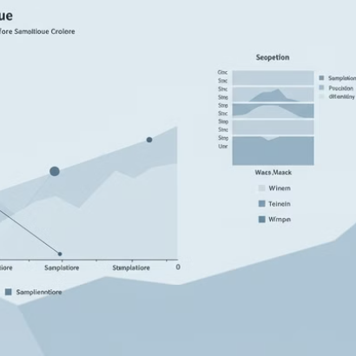
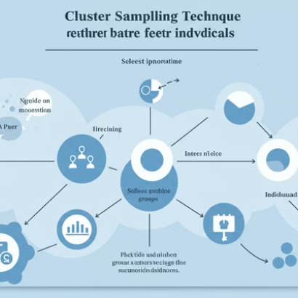
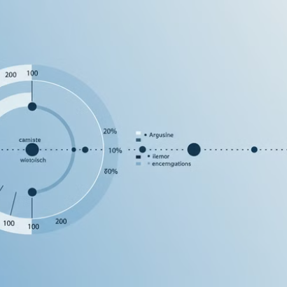
Probability Sampling Techniques
Probability sampling gives every element in the population a known chance of selection. This enables statistical inference about the population from the sample.

Slide 22
Non-Probability Sampling Techniques
Convenience Sampling
Purposive Sampling
Snowball Sampling
Selecting readily available cases. Quick and inexpensive but potentially biased.
Selecting cases based on specific characteristics. Useful for specialized populations.
Participants recruit additional subjects. Effective for hard-to-reach populations.
Example: Surveying customers currently in a store.
Example: Interviewing experts in a particular field.
Example: Studying business networks through referrals.

Slide 23
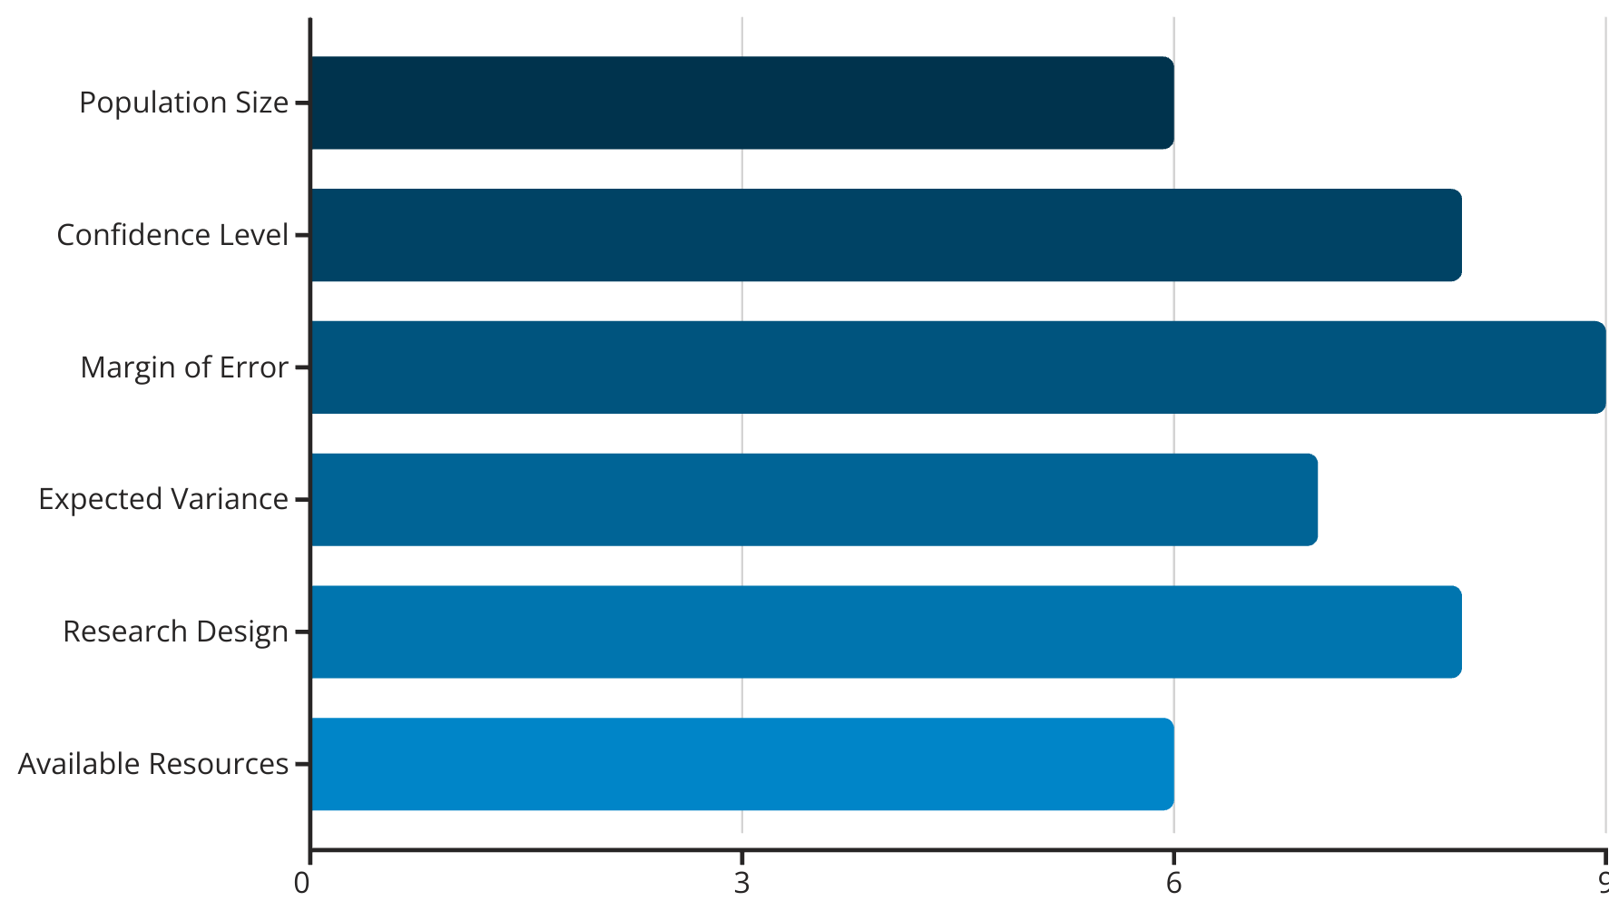
Sample Size Determination
Sample size significantly impacts research validity. Larger samples increase precision but require more resources.

Slide 24








Collecting Primary Data: Introduction
High Control
Custom-designed for specific research needs
Current & Relevant
Up-to-date information specific to research questions
Exclusive Ownership
Original data unavailable to competitors
Resource Intensive
Requires significant time, effort, and budget

Slide 25
Observations as a Data Collection Method
Types of Observations
Advantages
Limitations
Participant observation
Captures actual behavior
Time-consuming
Non-participant observation
Provides contextual data
Observer bias risk
Structured observation
Reveals unspoken patterns
Limited to observable actions
Unstructured observation
Minimizes subject reactivity
Ethical considerations

Slide 26





Conducting Observational Research
Planning Phase
Define observation objectives. Select observation type. Develop observation protocol with clear categories.
Execution Phase
Enter field setting. Document behaviors systematically. Maintain awareness of potential observer effects.
Recording Phase
Use field notes, checklists, or digital tools. Document context and non-verbal cues.
Analysis Phase
Code observations. Identify patterns and themes. Integrate with other data sources.

Slide 27





Surveys as a Data Collection Method
Paper Surveys
Online Surveys
Telephone Surveys
Traditional format. Useful for populations with limited digital access. Higher response rates in face-to-face settings.
Cost-effective and scalable. Enables complex logic and multimedia. Quick data collection and analysis.
Allows clarification of questions. Higher response rates than online. Enables reaching diverse populations.
Mobile Surveys
Captures in-the-moment feedback. Enables location-based research. Higher engagement with younger demographics.

Slide 28

Designing Effective Surveys
1
Define Clear Objectives
Establish exactly what information you need. Align questions with research goals and theoretical framework.
2
Select Question Types
Choose appropriate formats: multiple choice, Likert scales, ranking, or open-ended. Match format to information needs.
3
Craft Unbiased Questions
Use neutral language. Avoid leading questions, double-barreled questions, and loaded terminology.
4
Test and Refine
Conduct pilot testing with representative respondents. Revise based on feedback and response patterns.

Slide 29
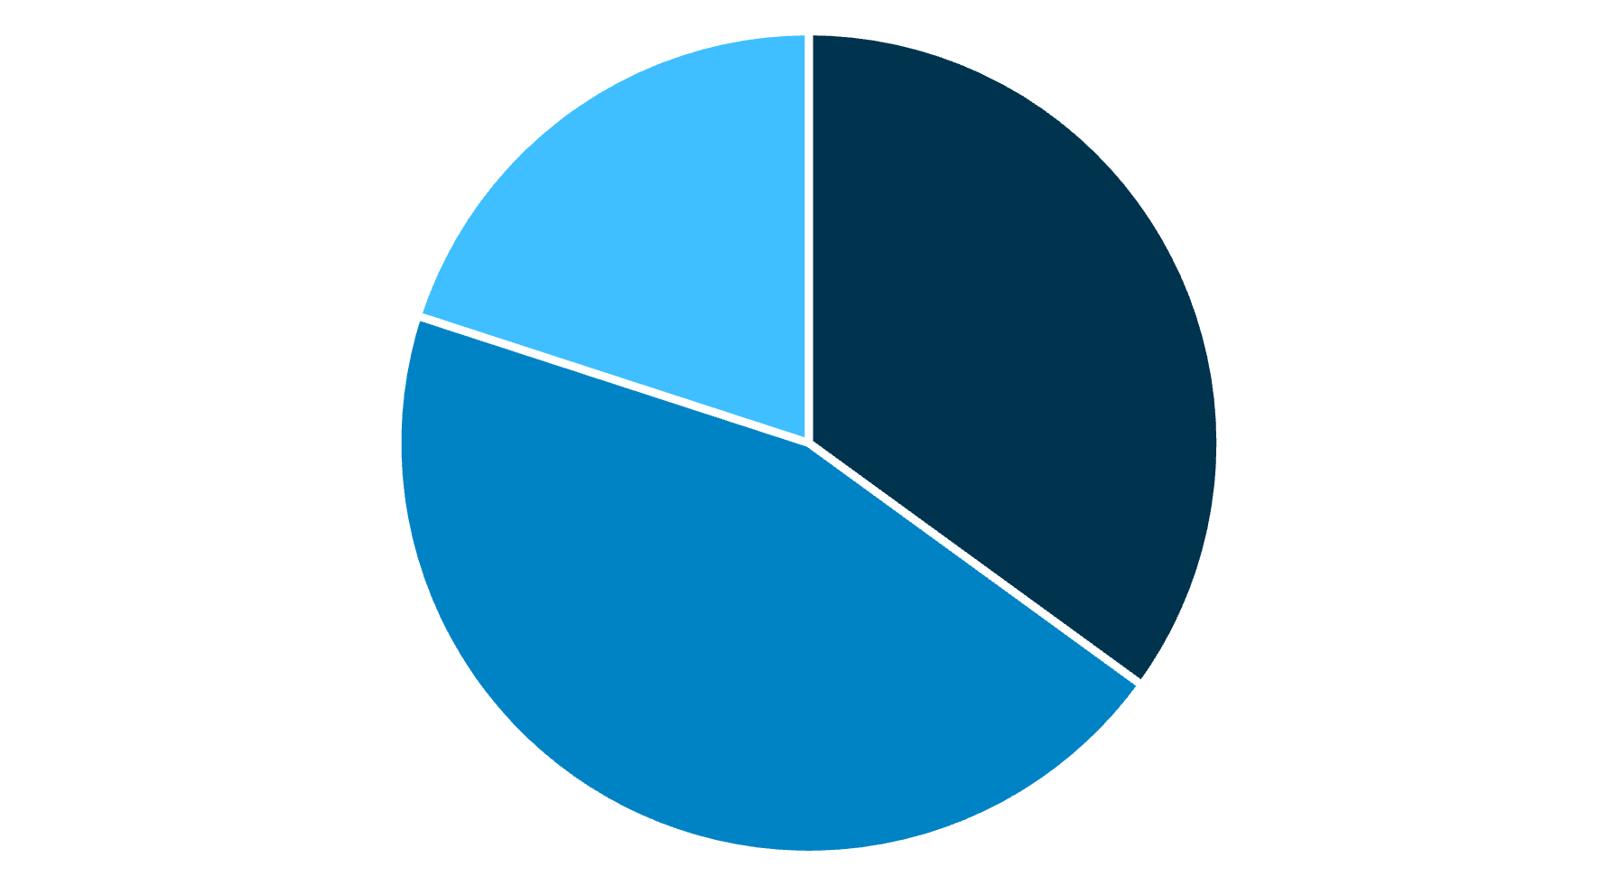
Interviews as a Data Collection Method
Structured
Semi-structured
Unstructured
Interviews provide rich, detailed data through direct interaction with participants. They allow for exploring complex topics and clarifying responses in real-time.
Semi-structured interviews are most popular in business research, balancing consistency with flexibility to explore unexpected insights.

Slide 30

Conducting Effective Interviews
Preparation
Develop interview guide. Research participants' backgrounds. Test recording equipment. Prepare consent forms.
Establishing Rapport
Begin with introduction and small talk. Explain research purpose and confidentiality. Create comfortable atmosphere.
Active Interviewing
Ask clear questions. Listen attentively. Probe for deeper insights. Observe non-verbal cues.
Documentation
Record with permission. Take strategic notes. Transcribe accurately. Verify understanding with participants.

Slide 31

Focus Groups as a Data Collection Method
Purpose
Focus groups capture group dynamics and collective opinions. They generate insights through participant interaction and discussion.
Structure
Typically 6-10 participants with similar characteristics. Led by skilled moderator using prepared discussion guide.
Advantages
Efficient data collection from multiple participants. Reveals diverse perspectives. Generates unexpected insights through interaction.
Limitations
Potential for groupthink or dominant personalities. Less depth than individual interviews. Logistical challenges of coordination.

Slide 32




Facilitating Focus Groups
Planning
Define objectives
Develop discussion guide
Select participants
Arrange logistics
Moderation
Establish ground rules
Facilitate balanced participation
Probe for deeper insights
Manage group dynamics
Analysis
Transcribe discussions
Code for themes
Analyze interactions
Identify consensus/disagreement

Slide 33
Experimental Methods in Business Research
Laboratory Experiments
Field Experiments
Natural Experiments
Conducted in controlled environments. Maximize internal validity through strict control of variables.
Conducted in real-world settings. Balance control with naturalistic conditions.
Occur without researcher intervention. Utilize naturally occurring events or policy changes.
Example: Testing different pricing strategies across different store locations.
Example: Studying impact of minimum wage increase on employee retention across state borders.
Example: Testing consumer responses to different packaging designs in a simulated store environment.

Slide 34










Ethical Considerations in Research
Privacy & Confidentiality
Informed Consent
Personal data must be protected. Identifiable information should be carefully secured or anonymized.
Participants must understand research purpose, procedures, risks, and benefits before agreeing to participate.
Risk Minimization
Research design should minimize potential harm to participants. Benefits should outweigh risks.
Cultural Sensitivity
Research methods must respect cultural differences and avoid imposing researcher values.
Respect for Autonomy
Participants' right to withdraw at any time must be respected without penalty.

Slide 35




Reliability and Validity in Research
Reliability
Consistency of measurement
Test-retest reliability
Inter-rater reliability
Internal consistency
Validity
Accuracy of measurement
Content validity
Criterion validity
Construct validity
Strategies for Improvement
Triangulation
Member checking
Pilot testing
Peer review

Slide 36



Data Analysis: Introduction
Quantitative Analysis
Qualitative Analysis
Mixed Methods Analysis
Statistical techniques to identify patterns and relationships in numerical data. Includes descriptive and inferential methods.
Systematic organization and interpretation of non-numerical data. Includes coding, thematic analysis, and narrative analysis.
Integration of statistical and textual analyses. Includes data transformation, comparison, and consolidation techniques.

Slide 37




Interpreting Research Results
Theoretical Implications
Connect findings to existing theories
Research Question Alignment
Assess how findings address original questions
Comparative Analysis
Contrast results with previous studies
Statistical Significance
Evaluate practical vs. statistical importance

Slide 38




Presenting Research Findings
Know your audience
Tailor content to their knowledge level and interests
Create a narrative
Structure findings as a coherent story with clear flow
Visualize key data
Use appropriate charts and graphics for clarity
Emphasize implications
Highlight practical applications of your findings

Slide 39
Limitations and Future Research
Common Limitations
Addressing Limitations
Future Research Directions
Methodological constraints
Acknowledge limitations honestly but without undermining your study. Explain how limitations were mitigated when possible.
Suggest specific follow-up studies that build on your work. Identify emerging questions raised by your findings.
Sample limitations
Time and resource restrictions
Measurement challenges
Contextual boundaries
Demonstrate awareness of how limitations affect the interpretation of your findings.
Recommend methodological improvements for subsequent research endeavors.

Slide 40

Conclusion: The Impact of Business Research
70%
Decision Quality
Companies using research-based decisions report higher success rates
3x
ROI Impact
Research-informed strategies deliver triple the return on investment
65%
Innovation Rate
Research-driven companies introduce successful innovations more frequently
40%
Risk Reduction
Evidence-based approaches significantly lower business failure rates

